Slide 1
DNA Fingerprinting Learning Goals
Learn/practice basic laboratory skills
Discuss DNA fingerprinting
DNA fingerprinting Activity & Analysis

Slide 2
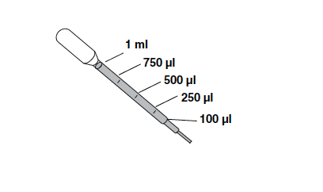
Biomedical Basic Laboratory Skills
Pipetting
  Transfer pipet
    Practice
  Micropipet
    Practice
Sterile Technique & making a streak plate
Casting Gels
Gel Loading

Slide 3
What is DNA profiling?
DNA profiling is the use of molecular genetic methods to determine the exact genotype of a DNA sample in a way that can basically distinguish one human being from another
The unique genotype of each sample is called a DNA profile.

Slide 4
Misconceptions of DNA Fingerprinting & Forensics
Forensic scientists only work on murders
They’re raking in the cash
They interrogate suspects and make arrests
DNA evidence wraps up every case
Tests are done in a matter of hours
Forensic analysts never make mistakes
Criminals always make mistakes
Forensics labs are high-tech and stocked with all necessary equipment,
Crimes are solved quickly
You have to have a catchy one-liner about every death

Slide 5
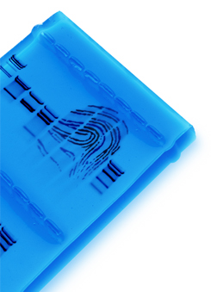
DNA Fingerprinting – Additional Applications
Crime scene
Human relatedness
Paternity
Animal relatedness
Anthropology studies
Disease-causing organisms
Food identification
Human remains
Monitoring transplants

Slide 6
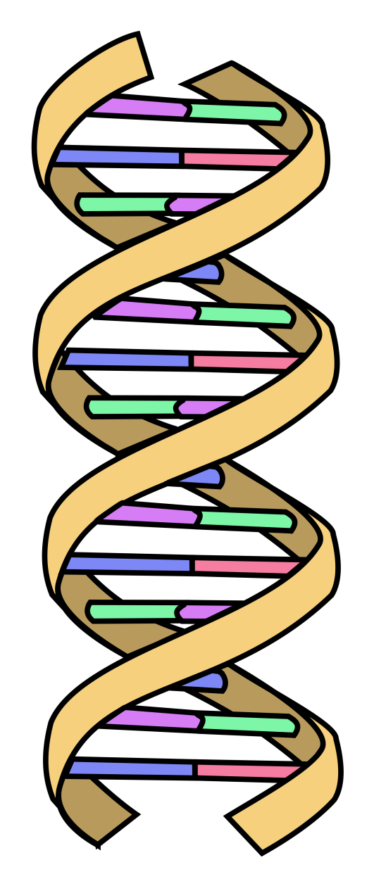
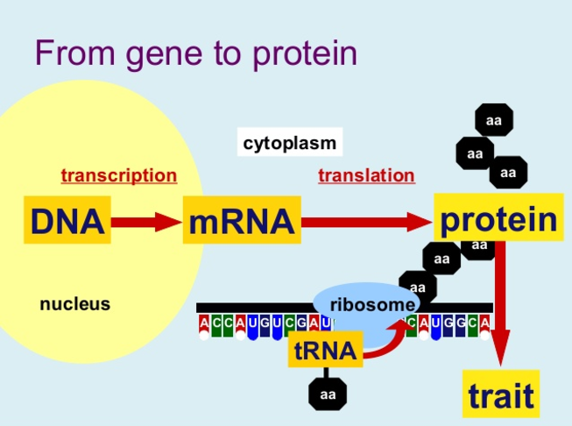
Reviewing DNA Structure and Function
A gene is a piece of DNA that codes for a protein. Proteins give the organism a particular trait.

Slide 7
How do crime scene investigators create a DNA profile?
1. Evidence is collected at the crime scene:
Blood Tissue
Semen
Urine
Hair
Teeth Saliva Bone

Slide 8
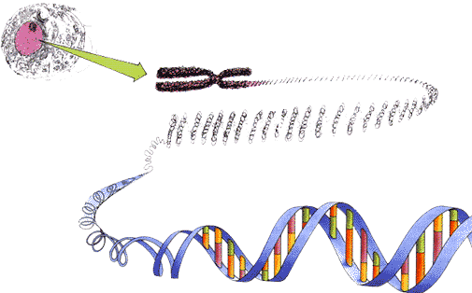
How do crime scene investigators create a DNA profile?
2. DNA is extracted from sources at the crime scene and from victim and suspects

Slide 9
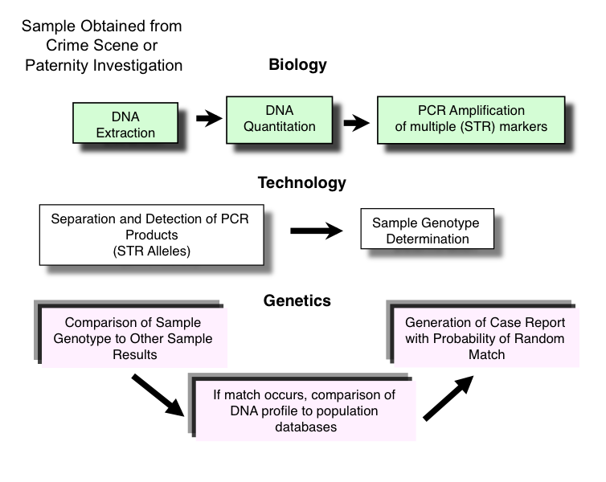
How do crime scene investigators create a DNA profile?
DNA samples are processed

Slide 10
Since humans are 99.9% identical where do crime scene investigators look for differences in DNA profiles?
4. Crime Scene Investigators search in areas of the genome that are unique from individual to individual and are “anonymous” (control no known trait or function) The areas examined are Short Tandem Repeats or STR’s
STR region
Notes:
Get video of STRs

Slide 11
Example of an STR: TH01
The TH01 locus contains repeats of TCAT.
CCC TCAT TCAT TCAT TCAT TCAT TCAT AAA
This example has 6 TCAT repeats.
There are more than 20 known TH01 alleles.
Each individual inherits 1 allele from each parent.

Slide 12
Determining genotypes for individuals using STRs
Ms. Smith’s TH01 locus for her two chromosomes is given below.
What is her genotype?
MOM’S CHROMOSOME
CCC TCAT TCAT TCAT TCAT TCAT TCAT AAA
DAD’S CHROMOSOME
CCC TCAT TCAT TCAT TCAT TCAT TCAT TCAT TCAT TCAT TCAT TCAT TCAT TCAT TCAT AAA
Notes:
he genotype is simply the two alleles at any particular locus. In this case, the TH01 genotype is 6,14 (or 14, 6).

Slide 13
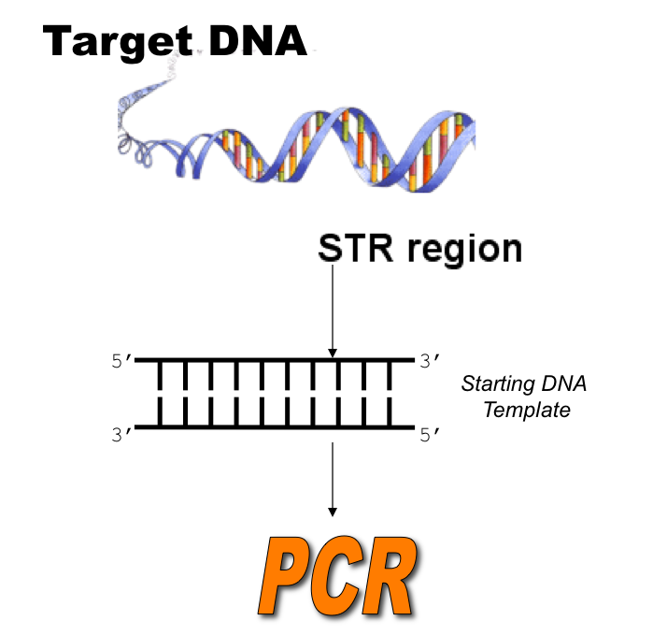
To determine the genotype (DNA profile) Crime Scene Investigators make billions of copies of the target sequence using PCR

Slide 14
What’s the point of PCR?
PCR, or the polymerase chain reaction, makes copies of a specific piece of DNA
PCR allows you to look at one specific piece of DNA by making copies of *only* that piece of DNA

Slide 15
DNA profiling is used to determine which suspect can not be excluded from suspicion.

Slide 16
How are suspects included or excluded from an investigation?
Suspects are included in an investigation if their DNA profile matches with genotypes found at the crime scene
Suspects can be excluded if their DNA profile does not match genotypes found at the crime scene

Slide 17
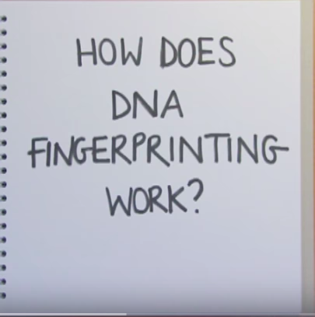
DNA Fingerprinting
Notes:
We

Slide 18
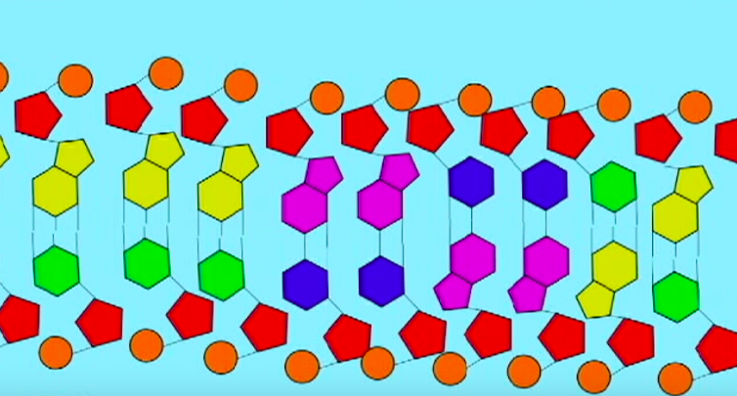
Restriction Enzymes in DNA Fingerprinting
Notes:
We aren’t actually using human DNA we are using bacteria DNA samples You are going to use restriction enzymes to cut the bacterial dna into pieces and we will use gel electrophoresis to separate these dna fragments

Slide 19
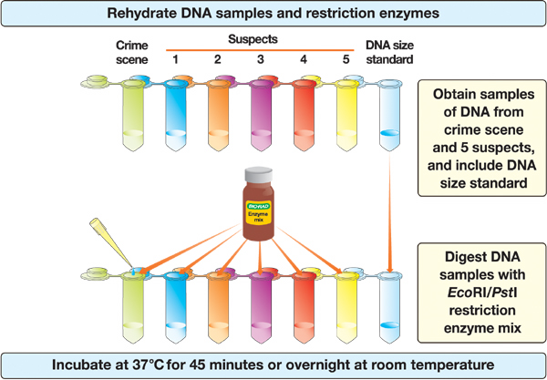
Procedure

Slide 20
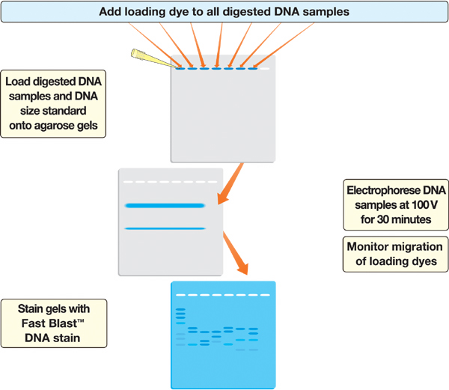
Procedure

Slide 21
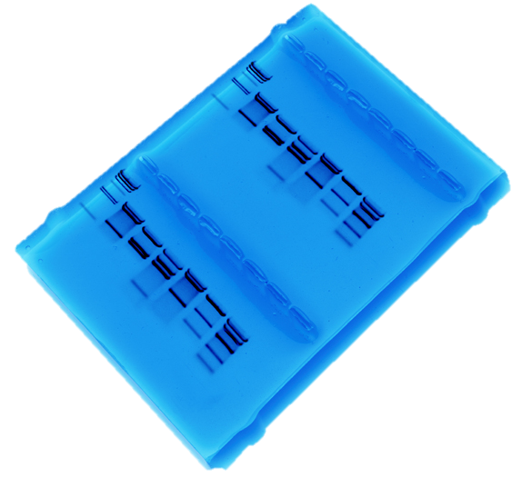
To Analyze Stained Gel
• Create standard curve using DNA marker
• Measure distance traveled by restriction fragments
• Determine size of DNA fragments
• Determine which suspects can be excluded

Slide 22
Quantitative Analysis
Electrophoresis data: Measures the distance (in millimeters) that each fragment travels from the well. This information is recorded. Scientist estimate its size, in base pairs, by comparing its position to the HindIII lambda DNA standards.
A standard curve is created.
Notes:
We are doing this by hand but in the lab the gels are red by machine and computer software does the analysis to make sure everything is as accurate as possible. Follow instructions on your sheet.

